Slide 1
Exploring Multimodal Approaches for Autism Detection:
Deep Learning Models and Machine Learning Algorithms
Presented By:
Group ID: T2320047
Tania Sultana Tamanna- 20101384
Razin Sumyta Monsoor - 20101529
Shehrin Hoque - 20101148
Mahmudul Hassan - 24141223
Rageeb Mohammad Ridwan - 23241073
Supervisor
Dr. Md. Ashraful Alam, PhD
Associate Professor
Department of Computer Science & Engineering
Brac University

Slide 2
Introduction
Autism Spectrum Disorder (ASD)
Understanding complexities and nuances
Problem Statement
Primary Objective
Deep learning models used- VGG16, VGG19, MobileNet, EfficientNet B4, Custom Model
Machine learning models used- ANN, KNN, Random Forest, Logistic Regression, Custom Model

Slide 3
Our Contribution
Our research paper is the first to simultaneously explore autism detection using both image and behavior datasets.
Our research encompassed datasets comprising both children and adults.
Comprehensive study on different types of data for autism detection
Make diagnosis less scary
Raise awareness
We achieved high accuracy in most of our models.

Slide 4
Challenges
Couldn't find a behavior dataset precisely matching the image dataset of exact patients
Direct comparison or integration of diverse results into a unified model was not feasible.
Employed combined model approaches for both data types, but accuracy achieved was subpar
Available Image datasets predominantly child based.
Limited Asian feature datasets accessible on public platforms.
Autism related institutions in Dhaka reluctant to share patients data.

Slide 5
Related Work (1):
Detecting Autism from Facial Images [ 1]:
Used Convolutional Neural Network with transfer learning
Collected images from ImageNet database
Implemented VGG19 to classify autistic or non autistic
Accuracy: 84.67%
Lack of diversity in the dataset
Lack of details for the evaluation of the model

Slide 6
Related Work (2):
Classification and Detection of Autism Spectrum Disorder based on Deep Learning Algorithms [2]:
Applied pretrained models Xception , VGG19 and NASNETMobile
Xception accuracy: 91%
VGG19 accuracy: 80%
NASNET Mobile accuracy: 78%
Chances of overfitting

Slide 7
Related Work (3):
Early detection of Autism spectrum disorder using traditional machine learning models [3]:
Data from different social networks and organizations were collected
Dataset contained experiences of parents regarding their autistic child using dialogue
KNN, SVM, LR and RF were used as models
SVM accuracy: 71%
LR accuracy: 71%
KNN accuracy: 62%
RF accuracy: 69%
Not applicable for large dataset
Low accuracy

Slide 8
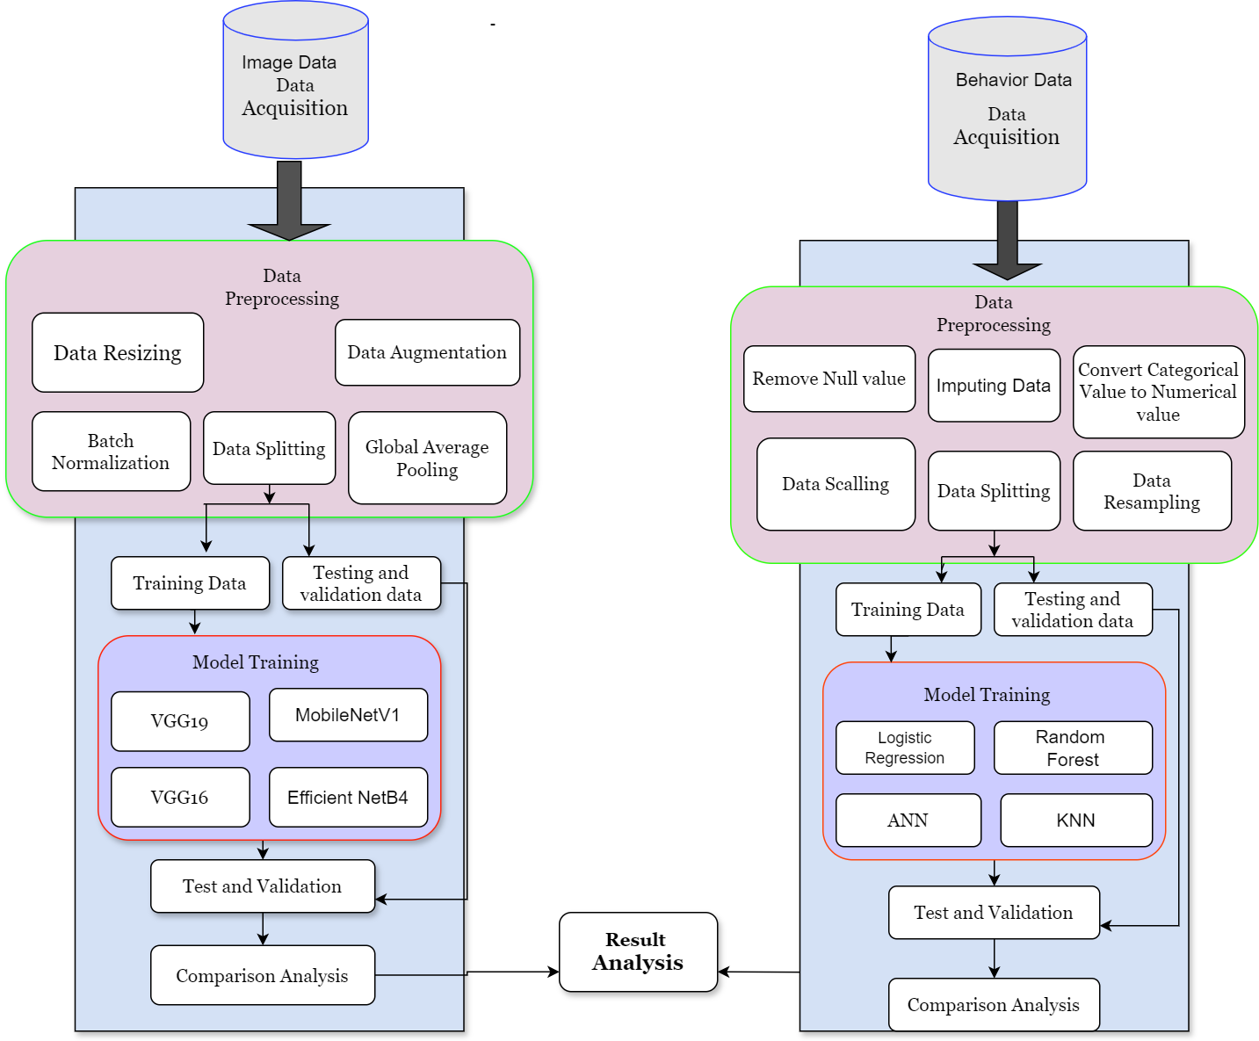
Work Flow
Data collection
Pre Processing
Training
Testing
Evaluation
Fig 1: Step By Step Workflow to Detect ASD

Slide 9
Dataset Description
Image Dataset
Source: Kaggle (Facebook & autism-related websites)
Total Photos: 2940
Photo Format: 2D, JPG
Photo Size: Varies
Adult Dataset for Autism Screening
Source: Kaggle
Total Instances: 704
Attributes: 21

Slide 10
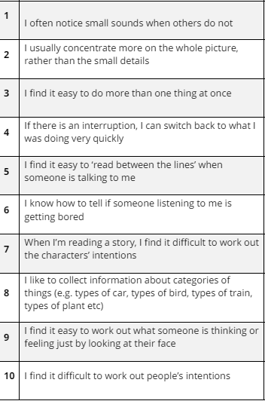
Dataset Description
Autism Screening of Toddlers
Dataset 1:
Source: Kaggle
Total Cases: 1054
Attributes: 18
Dataset 2:
Source: University of Arkansas Research
Total Instances: 1985
Attributes:21
Fig 2: Ten ASD Questions

Slide 11
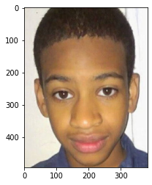
Image Data Preprocessing
Resized image
Every input images is resized to 224*224 pixels
Data Augmentation
An augmentation layer is added in our model before the base model
Batch Normalization
Images are normalized by dividing the pixel values by 255, ensuring they fall within the [0, 1] range
Fig 3: Resized image

Slide 12
Image Data Preprocessing
Data splitting
Training Data : 80 percent
Testing data: 10 percent
Validation data:10 percent
Additional layers
Global max pooling
Dense layer
Dropout layer
Output layer
Early Stopping
Early stopping was used to prevent overfitting

Slide 13
Tabular Data Preprocessing
Identifying common columns
Selecting and Concatenating Relevant Columns
Renaming Columns to ensure Columns name for merging.
Handling Categorical Data
Standardize Categorical values
Replace Inconsistent Values
Handling Missing Value
Replace Missing Values With “np.nan”
Impute using “SimpleImputer” with 'most_frequent' strategy

Slide 14
Tabular Data Preprocessing
Feature Engineering
Scaling Features
Create new feature to match with other dataset features
Encoding Categorical Variables
Binary Encoding to categorical features
Convert ‘Yes/No’ to 0/1
Train-Test Split
Training Data:80 %
Testing Data:20%
Label Encoder

Slide 15
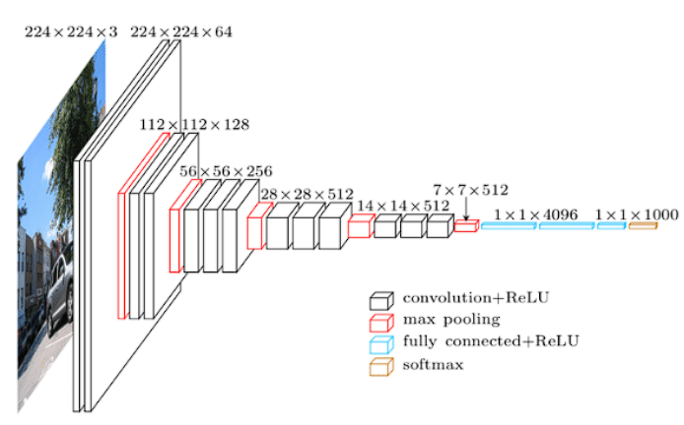
DL Models - VGG16
Used VGG19 as base model and added custom layers by excluding the top fully connected layers
Added 3 custom dense layers with ReLU activation to introduce non-linearity
Added a custom output layer with softmax activation for binary classification
Early stopping and LR scheduling
Then the model was compiled, trained, evaluated and tested
AUC (80%) , accuracy (73%), precision(73%), recall (73%), f1 score (73%)
Fig 3: VGG16 architecture

Slide 16
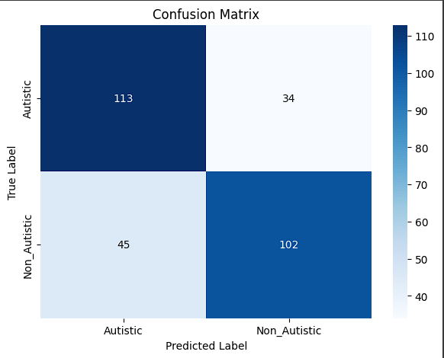
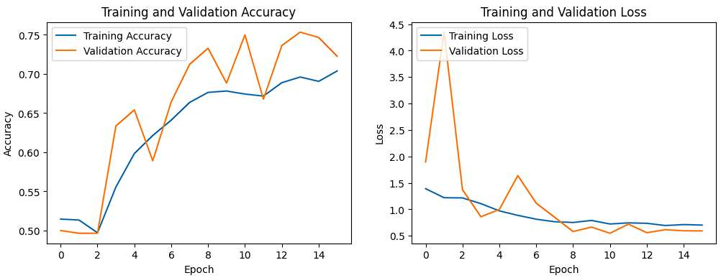
DL Models - VGG16

Slide 17
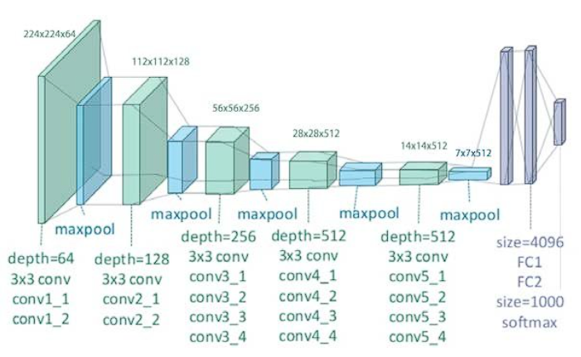
DL Models - VGG19
Used VGG19 as base model and added custom layers by excluding the top fully connected layers
Applied global max pooling to the output of the base model
Added dense layer with ReLU and 128 neurons
Then the model was compiled, trained, evaluated and tested
AUC (92%) , accuracy (84%), precision(84%), recall (83%), f1 score(83%)
Fig 4: VGG19 architecture

Slide 18
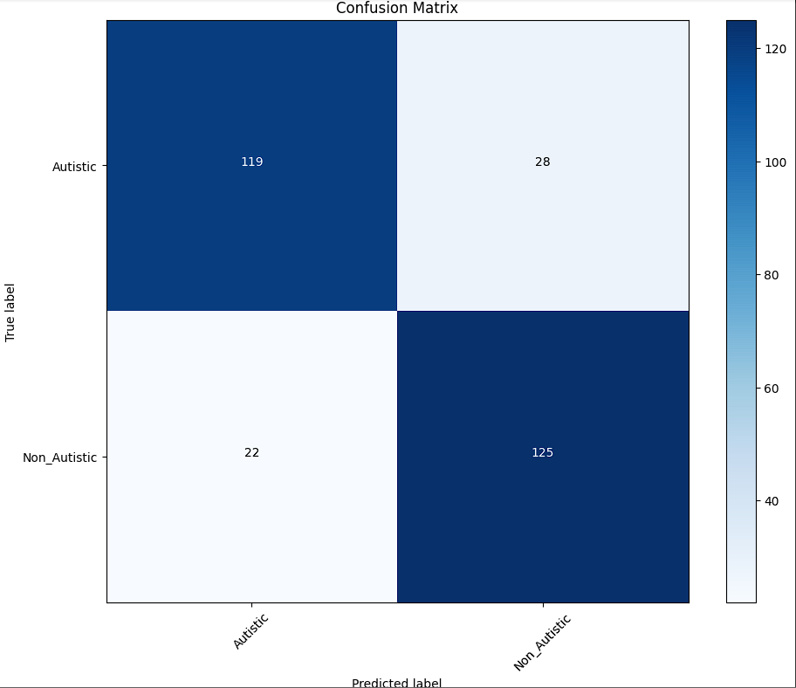
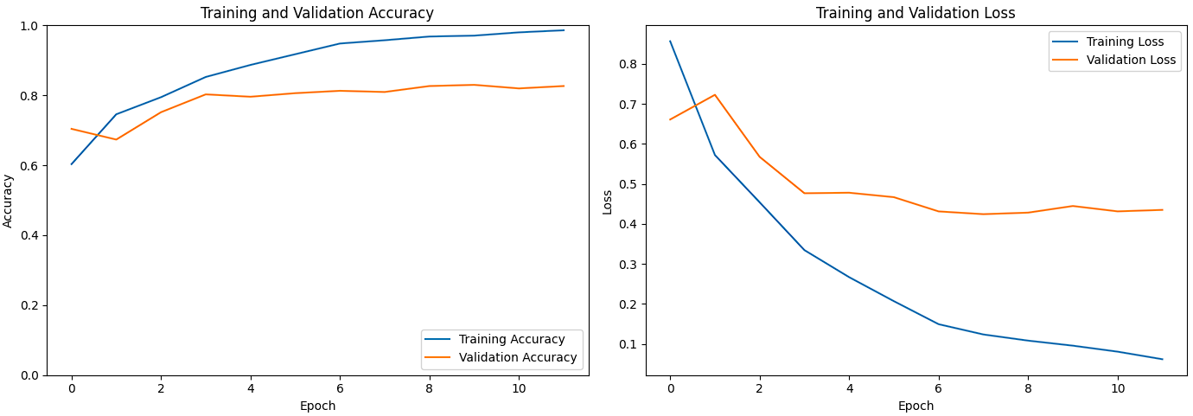
DL Models - VGG19

Slide 19
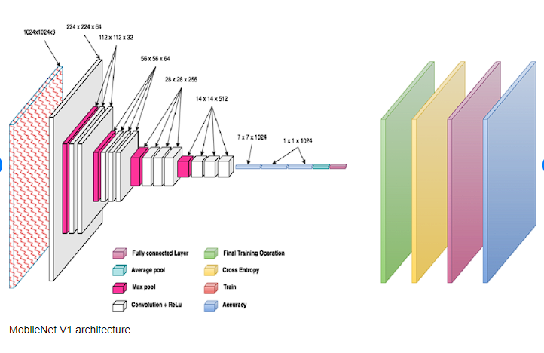
DL Models - MobileNetV1
We disabled the top fully connected layers and added custom layers.
We added a Global Average Pooling Layer to generate a feature vector after several DSC generate a set of feature maps
We added 2 dense layers with ReLU
Finally a softmax output layer
Then the model was compiled, trained, evaluated and tested
AUC (94%) , accuracy (86%), precision(86%), recall (86%), f1 score(86%)
Fig 5: MobileNetV1 architecture

Slide 20
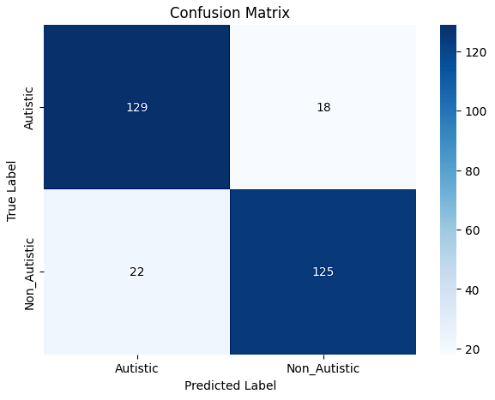
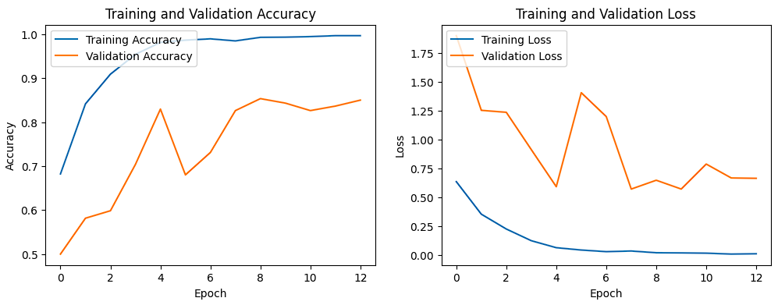
DL Models - MobileNetV1

Slide 21
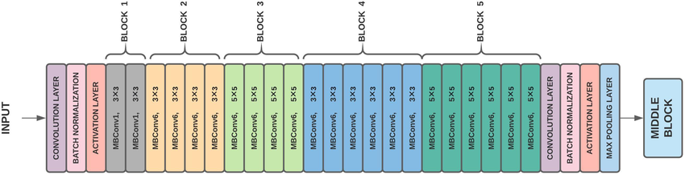
DL Models - EfficientNet B4
Freezing the final output layer we added some custom layers
Feature vector was generated by custom Global Average Pooling layer based on the average of the feature maps found after passing through MBConv and DSC blocks
The vector is then passed through the added dense ReLU layer following by the final output layer
Then the model was compiled, trained, evaluated and tested
AUC (95%), precision(89.68%), recall (89.45%), f1 score (89.48%)
Fig 6: EfficientNetB4 architecture

Slide 22
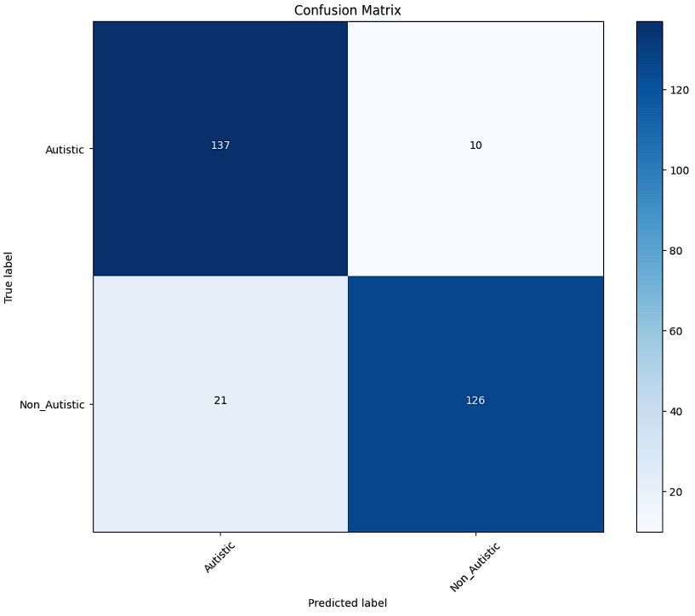
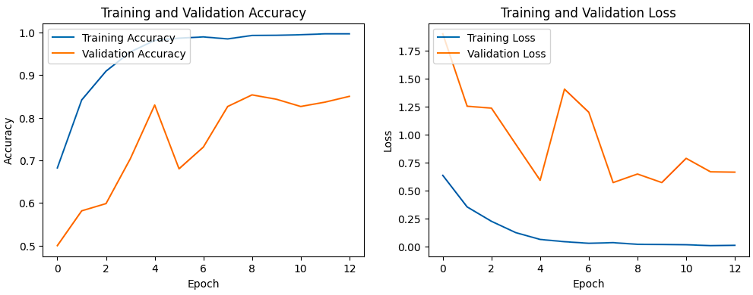
DL Models - EfficientNetB4

Slide 23
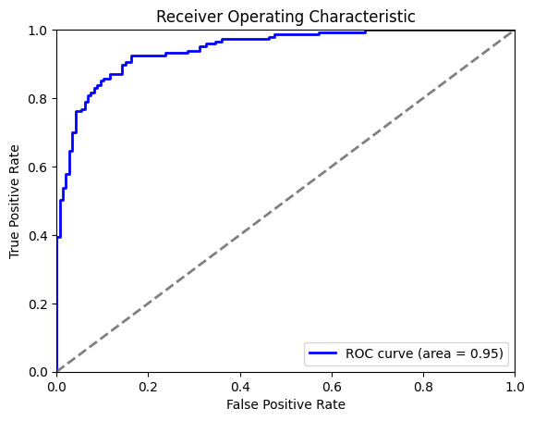
DL Models - EfficientNetB4

Slide 24
Multi-classification DL Models for Image Data - Efficient NetB4, VGG19 & MobileNetV1
Averaged the predictions from the three models to form ensemble predictions
Weights: EfficientNet B4- 45%, Mobile Net V1- 35% , VGG19-20%
Re-extracted the true labels to match with the predictions
AUC (95%), accuracy (91%), precision (90.5%), recall (91.2%) and f1 score (90.7%) of the ensemble predictions were generated later on.

Slide 25
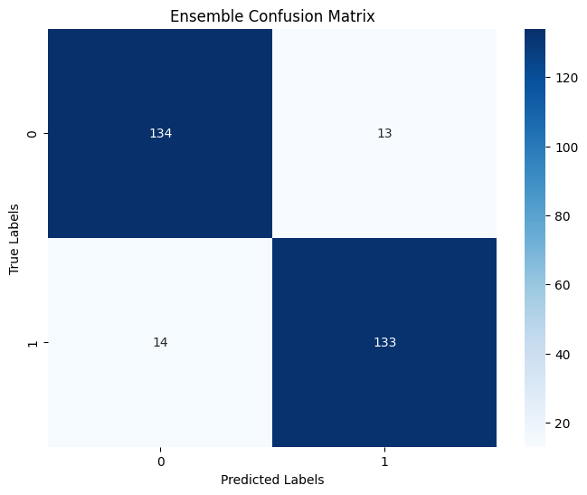
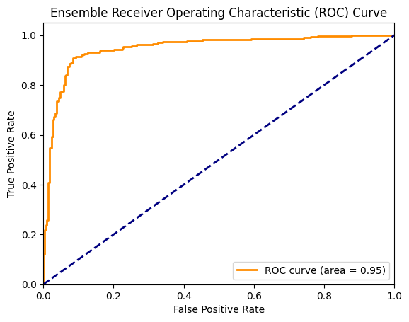

Slide 26
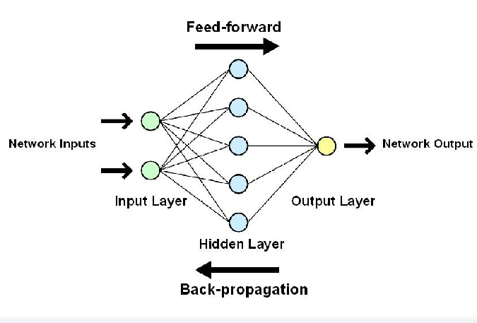
ANN (Artificial Neural Network)
Three layer model [5]
Numerative input- X trained scale dataset
1st hidden layer (128 neurons, ReLU activation)
2nd hidden layer (100 neurons, ReLU activation)
Output layer (2 neurons, Sigmoid function)
2 dense layers feature - (1024+512) neurons
Train loss above 30% , & Validation loss above 20%
Precision, Recall, and F1 scores (98.46, 1, and 99.22) %
Accuracy- 99.103%

Slide 27
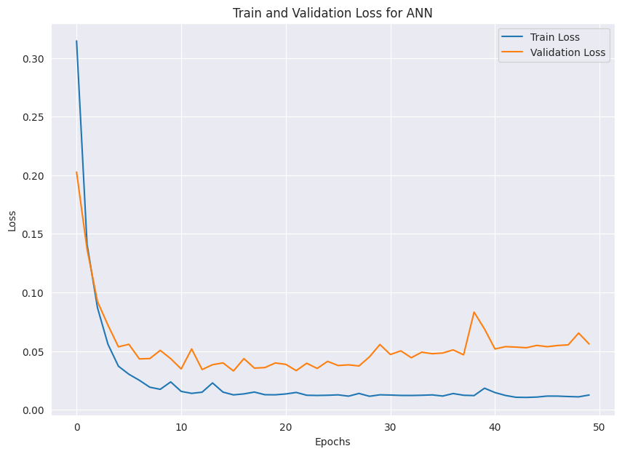
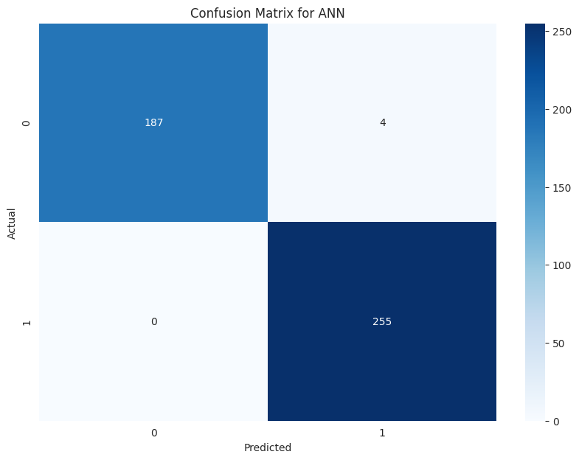

Slide 28

KNN (K-Nearest Neighbours)
Non parametric supervised learning classifier
Predictions based on labeled training datasets
Our model operates by assessing proximity and similarity
Fit function on the training data (X-train, Y-train)
Predictions made on the test data (X-test, Y-test)
Correctly predicted 177 instances of the first class
243 correct instances of the second class
Precision, Recall, F1 scores (92.67, 93.65, and 93.158) %
Accuracy- 94.17 %

Slide 29
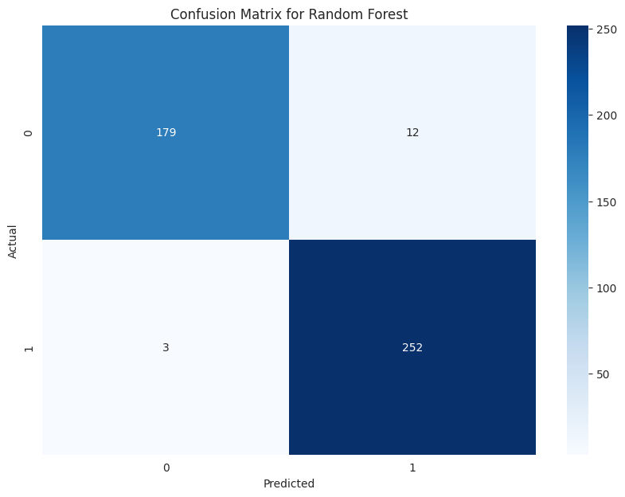
Random Forest
Useful in cases requiring high accuracy and robustness.
Random Forest combines multiple decision trees to improve accuracy and reduce overfitting.
We got an accuracy of 96.63% in our dataset with Random Forest. Precision, Recall and F1 scores are 98.35%, 93.71%, 95.97% respectively.

Slide 30
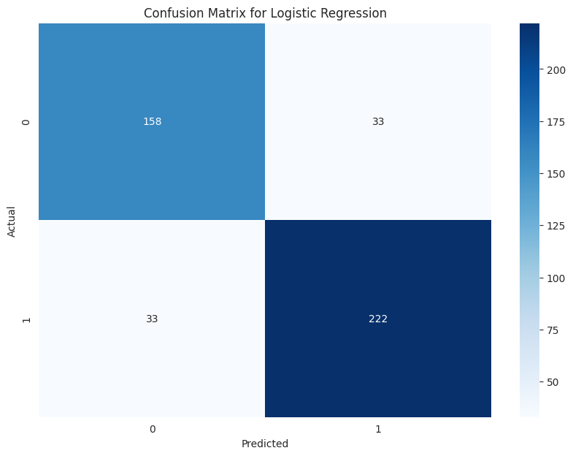
Logistic Regression
Logistic regression is good for simple, binary classification tasks with linearly separable data.
We got the accuracy of 85.20% with logistic regression.

Slide 31
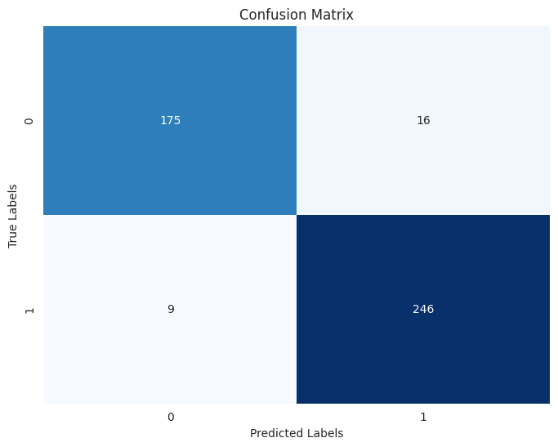
Multi Classification Model for Screening Data
Used Soft Voting Strategy
Four classifier was used: (equally weighted 25%)
Decision Tree
KNN
Random Forest
SVM
Achieved an ensemble accuracy of 94%

Slide 32
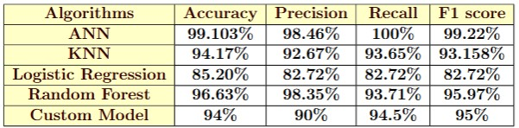
Machine Learning Algorithms Result Comparison
(Behavior Data)

Slide 33
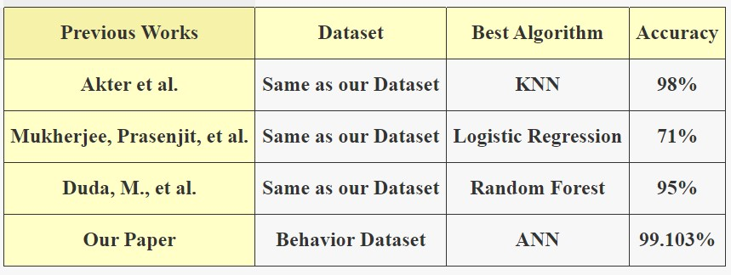
Accuracy Comparison with Other Papers on Behavior Dataset

Slide 34
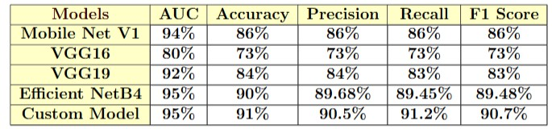
Deep Learning Models Result Comparison
(Facial Image Data)

Slide 35
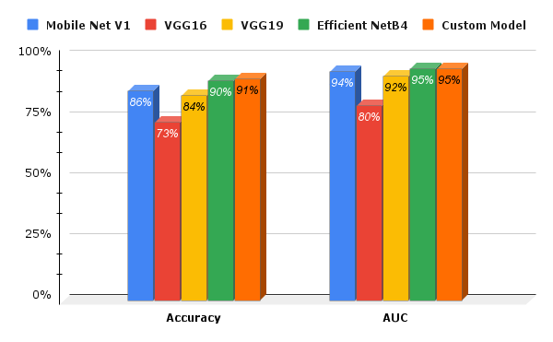
Deep Learning Models Result Comparison
(Facial Image Data)

Slide 36
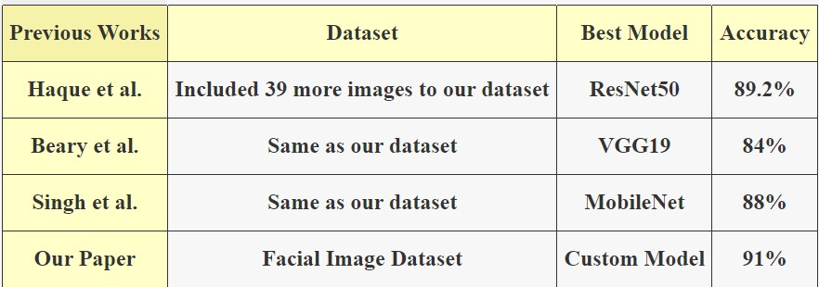
Comparing Custom Model with Previous Works using Same Dataset

Slide 37
Drawbacks
Dataset Limitation.
Privacy Concern.
Lack of Asian Children Images.
No Common Dataset of Images and Behavior combined.

Slide 38
Future Work
Collecting Asian Children Images.
Collecting a Common Dataset with Image and Behavior.
Creating a Web Interface Which Can Identify Autism Through Behavior/Image Data

Slide 39
Conclusion
We got the better accuracy than most of the existing papers in both approaches.
Our paper is the first one where a comparative study is presented about two different approaches to detect autism with behavior data and image data.
With the collection of common data this research can gave us an excellent outcome in future.

Slide 40
References
1.Shaik, J., & Padmanabhan, S. (2021). Detecting autism from facial image. International Journal of Advanced Research, 3.
2.Alsaade, F. W., & Alzahrani, M. S. (2022). Classification and detection of autism spectrum disorder based on deep learning algorithms. Computational Intelligence and Neuroscience, 2022.
3.Mukherjee, P., Sadhukhan, S., Godse, M., & Chakraborty, B. (2023). Early Detection of Autism Spectrum Disorder (ASD) using Traditional Machine Learning Models. International Journal of Advanced Computer Science and Applications, 14(6).
4. Singh, G. (2024b, May 23). Introduction to artificial neural networks. Analytics Vidhya. https://www.analyticsvidhya.com/blog/2021/09/introduction-to-artificial-neural-networks/

Slide 41
Thank You
Any Question?

